Slide 1
Understanding King County Evictions
Mwai Kennedy, Oyeleke Olaoye, Emily Flanagan,

Slide 2
What is eviction?

Slide 3
What is eviction?
Legal process of removing a tenant from a property

Slide 4
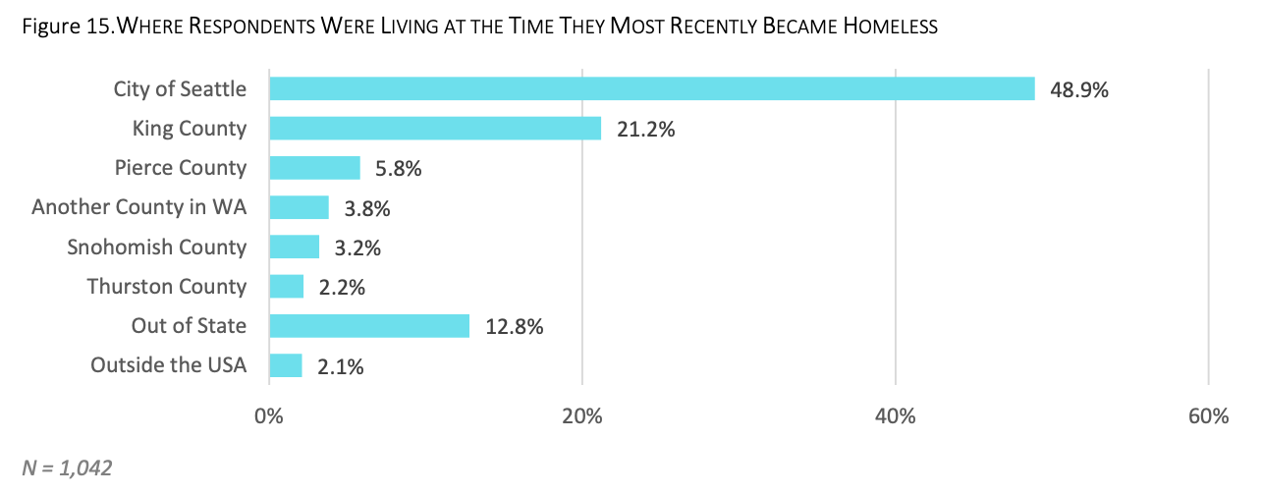
How does eviction relate to homelessness?
City of Seattle Homeless Needs Assessment 2016

Slide 5
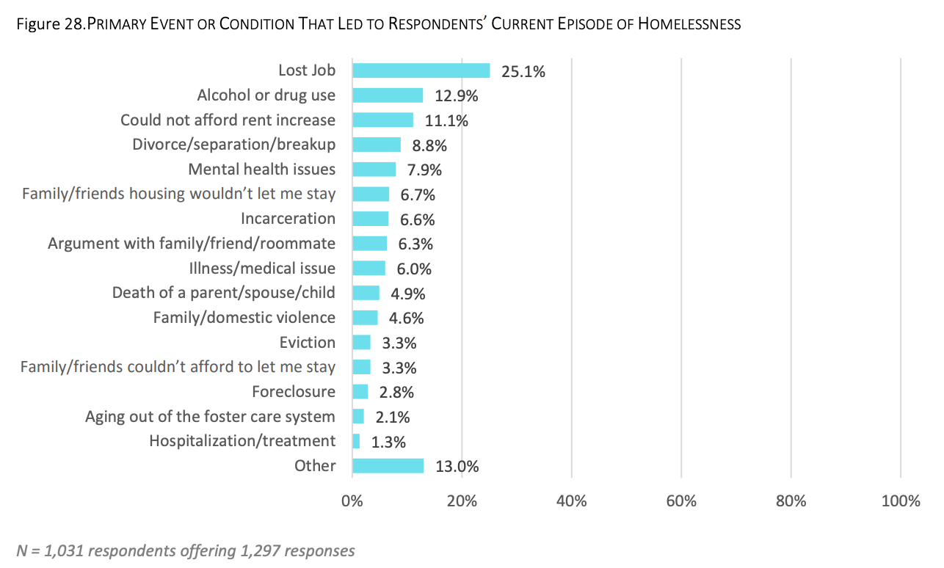
How does eviction relate to homelessness?
City of Seattle Homeless Needs Assessment 2016

Slide 6
Data
American Community Survey (2010 -2016)
Princeton Evictions Lab (2010 – 2016)

Slide 7
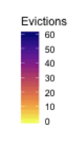
Where do evictions happen in King County?

Slide 8
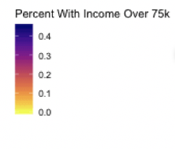
Where do evictions happen in King County?

Slide 9
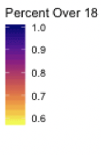
Where do evictions happen in King County?

Slide 10
Methods
Variable selection using LASSO
Percent of population under 18
Percent of population African American or Black
Percent of population Hispanic
Percent of population Pacific Islander or Native Hawaiian
Percent of population with income over 75k per year
Median property value

Slide 11
Methods
INLA model
Adjust for both space and time together
Adjust for neighboring spatial effect
Adjust for previous year

Slide 12
Methods
INLA model
Adjust for both space and time together
Adjust for neighboring spatial effect
Adjust for previous year
Unstructured model DIC : 4070.18 , pd=345.31
Spatial model - DIC : 4036.80,pd=323.79
Spatial Temporal - DIC : 3909.08, pd=329.29

Slide 13
Methods
Variable | Coefficient (sd) | Credible Interval
Percent Black or African American | 0.018(0.004) | 0.004-0.017
Percent Hispanic | 0.021(0.003) | 0.011-0.024
Percent Pacific Islander or Native Hawaiian | 0.018(0.012) | 0.003—0.051
Percent Under 18 | 0.06(0.356) | 0.702-1.849
Median Property Value | 0.0001(0.0) | 0.000-0.0001
Percent Income over 75k | -0.653(0.365) | -2.951- -1.630

Slide 14
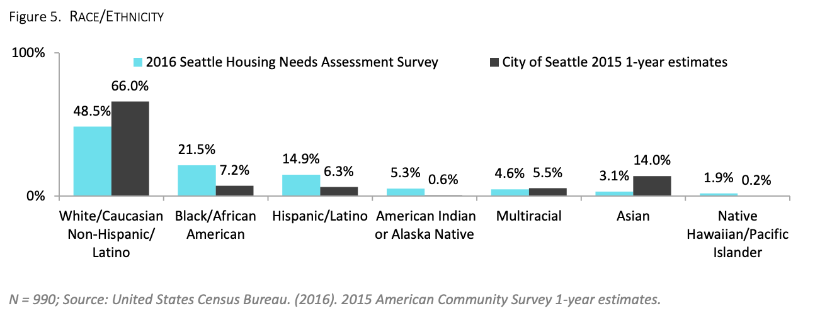
Connections
City of Seattle Homeless Needs Assessment 2016

Slide 15
What are the limitations?
Unclear who is being evicted and where they are going
Other types of housing displacement not accounted for
Rent increases
Foreclosure
Missing other types of data
Employment rates

Slide 16
References
City of Seattle 2016 Homeless Needs Assessment, Applied Survey Research 2017

